Slide 1
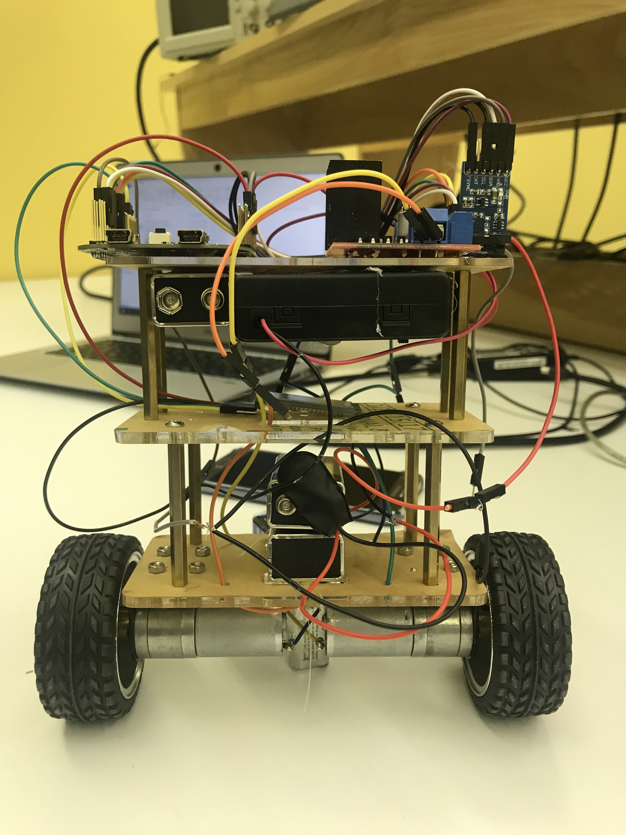
“self balancing robot”
COEN 6711- Microprocessors and their applications
Concordia university, fall- 2018
Team
Horia Petre (26035035)
Md. Shafayet Sajid (40075368)
Diego Mayorga (40075927)

Slide 2
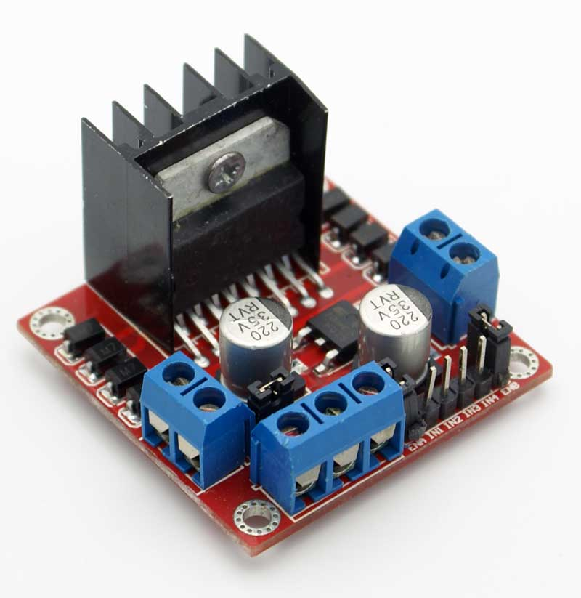
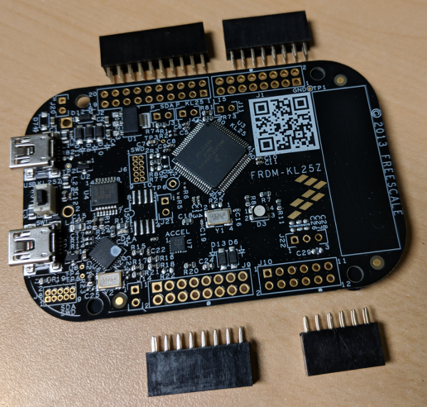
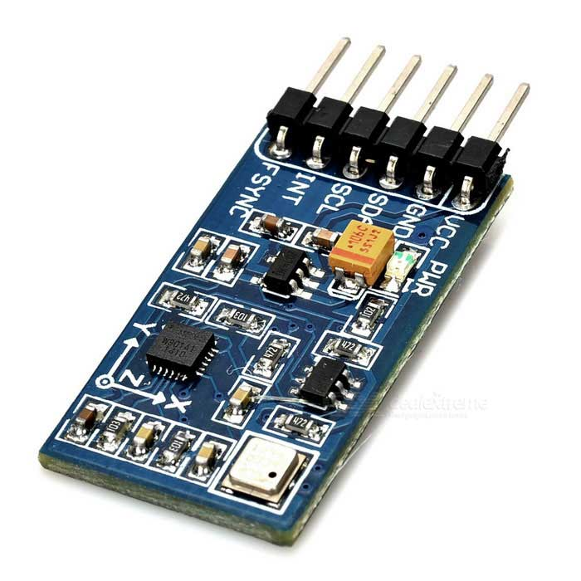
Main components
Microcontroller Board
Inertial Measurement Unit
Motor Drive Module

Slide 3



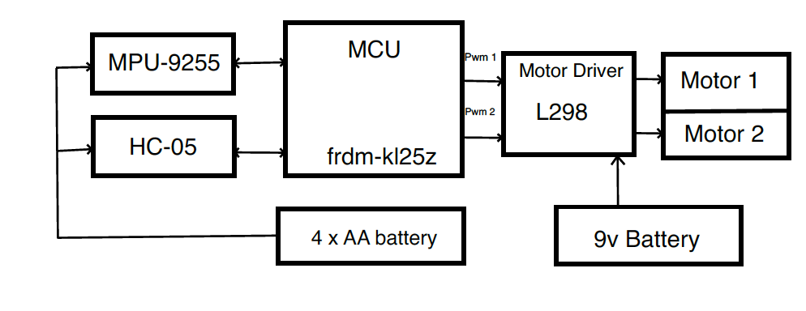
Circuit block
PID

Slide 4
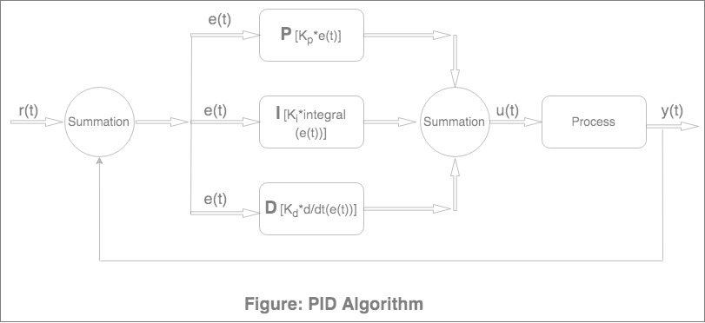

Slide 5
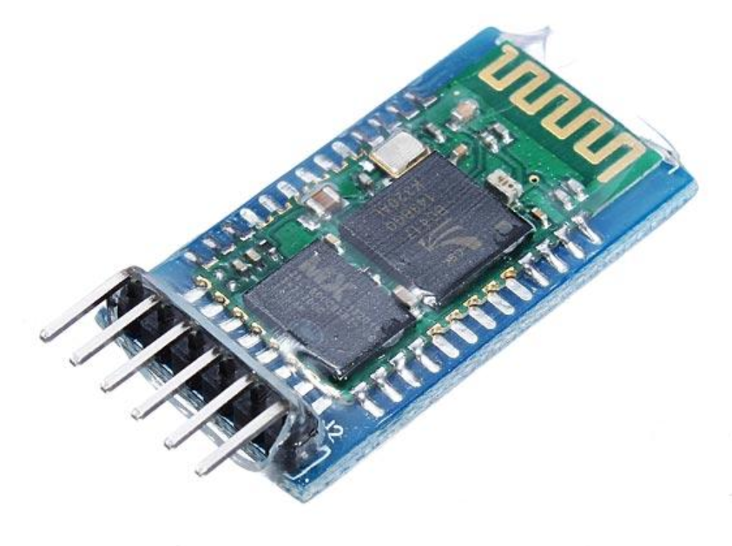
Bluetooth connection through mobile apps
Bluetooth Module
Mobile app

Slide 6
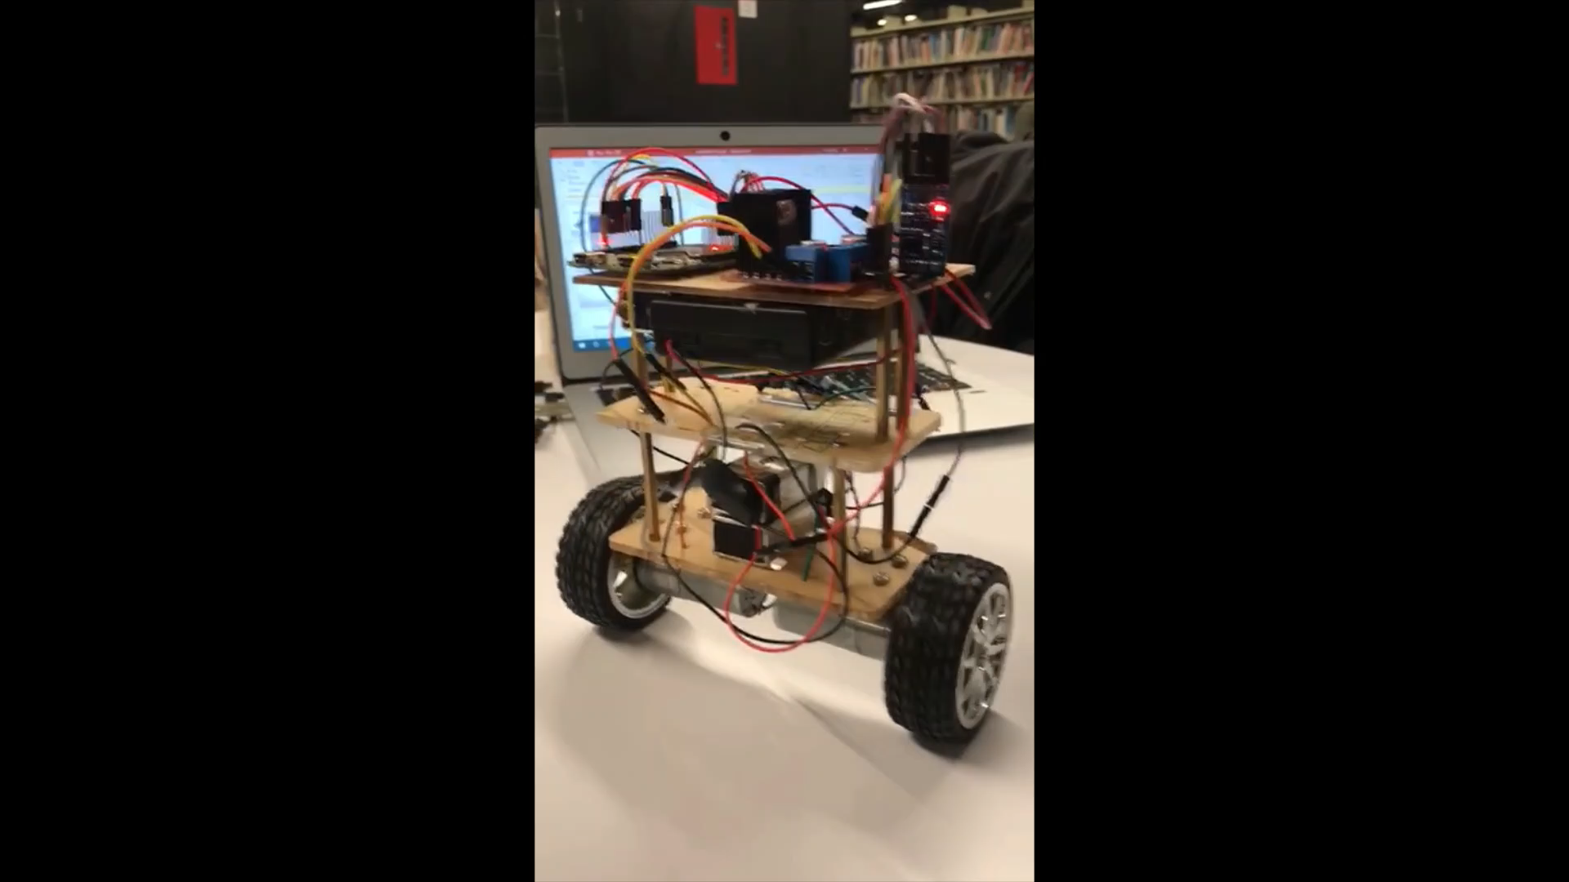
Results

Slide 7
Thank you

